Slide 1
CAD-IT IoT Centre NodeLinx Project: Machine Utilization
V1.0 | 13 JUNE 2023
Didi Setiawan
IoT Application Engineer

Slide 2

Landing Page
Machine Utilization
Calendar
Currency

Slide 3
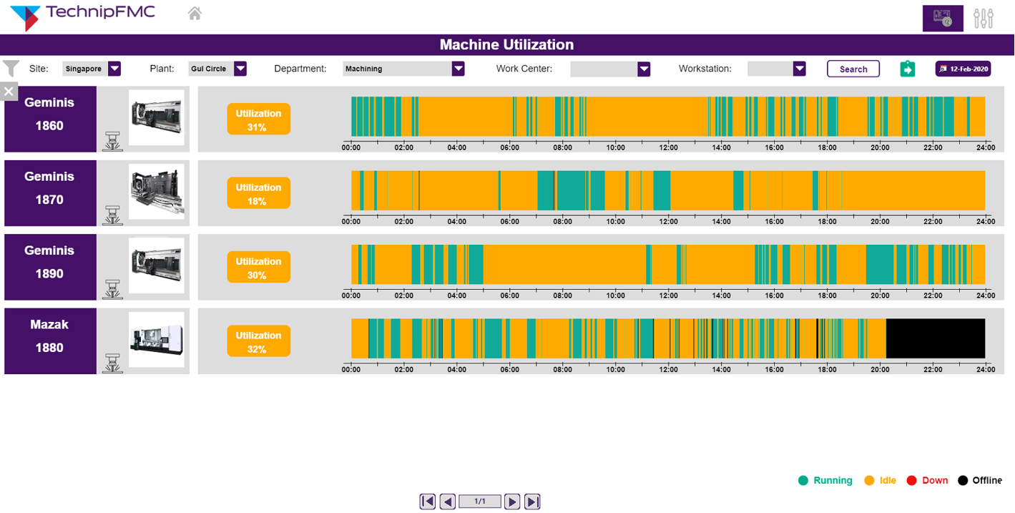

Task 3 – Machine Utilization
Machine Utilization
SEARCH
12-Feb-2020
Geminis
1860
Geminis
1870
Geminis
1890
Mazak
1880
1/1
Notes:
< 10% red <50% yellow
Else green

